Slide 1

Referral Outreach System:
My 3‑Week Roadmap
PROGRESS REPORT · SEP 24 – OCT 16, 2026
From mapping every nearby referral source to connecting the CRM with GoHighLevel
Prepared by the KAM Team
Notes:
Good morning, sir. This is a summary of what I built over the last three weeks for the Angels Oasis referral outreach system: week one the lead map, week two the email connection, and week three GoHighLevel. I'll also be clear about the one part that is still in research: sending the emails automatically from our CRM through GHL.

Slide 2




Three weeks, three building blocks
OVERVIEW
WEEK 1
WEEK 2
WEEK 3
Lead Map
Email Connection
GHL + Automation
Sep 24 – Sep 30
Oct 1 – Oct 9
Oct 10 – Oct 16
Build specification
Live map from 3 data sources
Leads + contacts database
CRM live on Vercel + Supabase
CRM → GHL contact webhook
Campaign Writer + approvals
8 referral emails written
All 8 built in GHL
Email sending: in research
Where it stands: the map, the CRM and the GHL emails are built. The last link, sending the emails automatically, is still in research.
Notes:
Each week built on the one before. First I needed to know who to contact, then I needed to connect the CRM to GHL, and then I built the emails in GHL. The final step, automated sending, is still being researched.

Slide 3
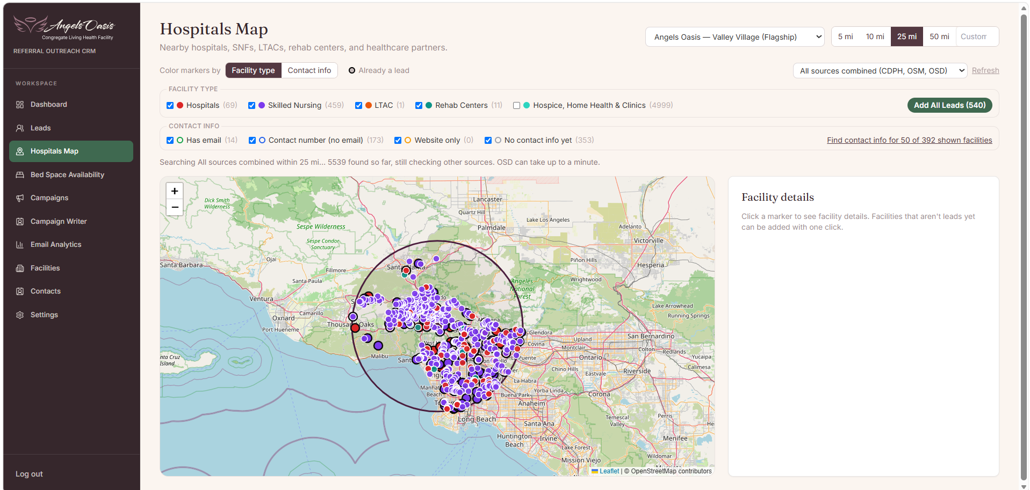
Built a live map of every referral source nearby
WEEK 1 · SEP 24 – SEP 30
5,500+
facilities found within 25 miles of Valley Village
3
data sources combined: CDPH, OpenStreetMap, OSD
540
hospitals, SNFs, LTACs and rehab centers ready to add as leads
The live Hospitals Map: 5, 10, 25 or 50-mile scan around either home, pins colored by facility type or contact info, and “Add All Leads” in one click
Notes:
Week one was about answering one question: who should we be talking to? The map now combines three public sources and found over 5,500 facilities within 25 miles. Of those, 540 are hospitals, nursing facilities, LTACs and rehab centers, and they can all be added as leads in one click.

Slide 4
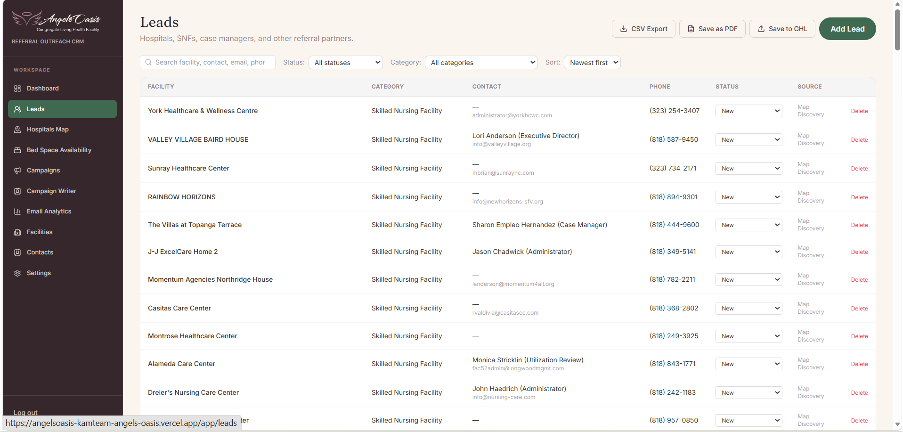



Every lead now has a stage in the pipeline
WEEK 1 · LEADS AND CONTACTS
New
Researched
Contacted
Engaged
Referral Received
Active Partner
Searchable lead database
Filter by status and category; every lead tagged with its source
Several contacts per facility
Director of Nursing, case manager, administrator, with one marked primary
Save to GHL, CSV or PDF
Send leads to GoHighLevel or export the list in one click
Leads page in the live CRM
Notes:
Leads don't just sit in a list. Each one has a stage, a source, and as many contacts as we can find at that facility. The Save to GHL button is the start of the connection to GoHighLevel.

Slide 5






Put the CRM online and started the link to GHL
WEEK 2 · OCT 1 – OCT 9
Live on Vercel
Supabase database
The CRM is deployed online; staff sign in from any browser
Leads, contacts and campaigns are saved in one secure database
CRM → GHL webhook
Campaign Writer
“Save to GHL” posts the lead to GHL, which creates the contact and tags it
Drafts the subject line, body, call to action and follow-up in minutes
Approval queue
Email analytics screen
Every campaign is approved, rejected or sent back for edits before it goes out
Built and ready; it will show real numbers once sending is connected
Notes:
Week two put the CRM online on Vercel with a Supabase database, and started the link to GoHighLevel: a webhook that creates the contact in GHL and tags it. The analytics screen is ready, but it will only show real numbers once sending is connected.

Slide 6



Wrote 8 referral emails, planned over 27 days
WEEK 3 · OCT 10 – OCT 16
DAY 0
DAY 2
DAY 5
DAY 8
DAY 12
DAY 20
DAY 27
0
2
5
8
12
20
27
Introduction
Value first
Soft bridge
Direct ask
Practical tip
In-service
Break-up
A neighbor in Valley Village
One-page discharge guide
6 beds, 24-hr nursing, 3:1
20-minute tour invite
What speeds up placement
Lunch session for the team*
Last note, direct line
*Leads in Riverside County / Inland Empire get a San Jacinto version on day 20 instead. All 8 emails are built in GHL as drafts (Oct 15).
Personal
Helpful before asking
Respectful
Each email fills in the contact’s first name, organization and role
The first emails give value; the tour ask comes on day 8
Every email has an easy opt-out: reply “no thanks”
Notes:
These are the eight emails, all branded with the Angels Oasis logo and footer, and all eight are now built in GHL as drafts. The order is deliberate: we help first, then introduce the home, then ask for a tour, and we close politely if they don't respond.

Slide 7




What works today, and what is still in research
WEEK 3 · HOW IT CONNECTS
Vercel CRM
Supabase
GHL webhook
GHL emails
Automated sending
Leads, contacts and “Save to GHL”
Stores every lead and campaign
Creates the contact, adds tag
All 8 referral emails
Vercel → Supabase → GHL
Working
Working
Test data received
Built as drafts
In research
Research in progress: the email connection from Vercel to Supabase to GHL
Nothing is confirmed yet. I can’t test the connection end to end without these credentials:
  GHL Private Integration token and Location ID, so the CRM can create contacts and send emails through GHL
  Supabase service-role key, so the server can read leads and trigger the sends securely
Notes:
This is the honest status. The CRM, the database and the webhook into GHL work, and all eight emails are built in GHL. What I'm still researching is the email connection from Vercel through Supabase into GHL, so the emails send automatically. I can't confirm anything there yet. To test it end to end I need two things: a GHL Private Integration token and Location ID, and the Supabase service-role key.

Slide 8






Extra features I added to the CRM
EXTRA FEATURES · BUILT ALONG THE WAY
LinkedIn profiles of key staff
One-click contact lookup
Click a hospital or SNF to see its case managers, DONs and administrators, with LinkedIn links
Finds each facility’s website, phone and email, and shows where every detail came from
Trusted contacts only
Bed space availability
Skips directory sites like Yelp and Healthgrades, so only the facility’s own contacts are kept
Open, closing soon or full, with open beds and referral status for each home
Outreach history
Faster, smoother CRM
Open any lead on the map to see every email already sent to it, and when
Lead search and sort, saved contact lookups and a branded loading screen
Notes:
Along the way I also added several features that make each lead easier to work. The biggest one: when you click a hospital or SNF on the map, the CRM now finds its key staff, such as case managers, discharge planners, directors of nursing and administrators, and links to their LinkedIn profiles. It also looks up each facility's website, phone and email, skips directory sites so we only keep the facility's own contacts, and shows bed availability and the outreach history for each lead.

Slide 9
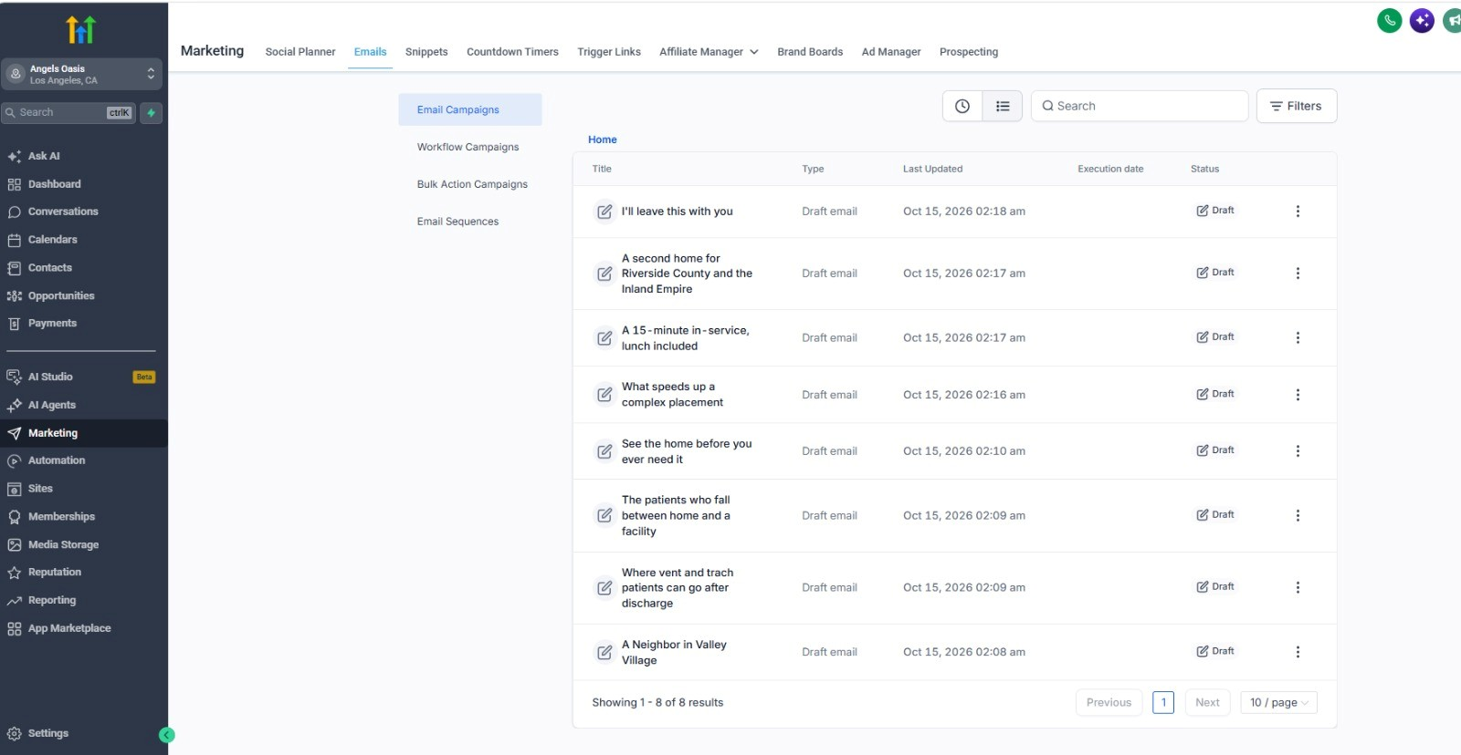
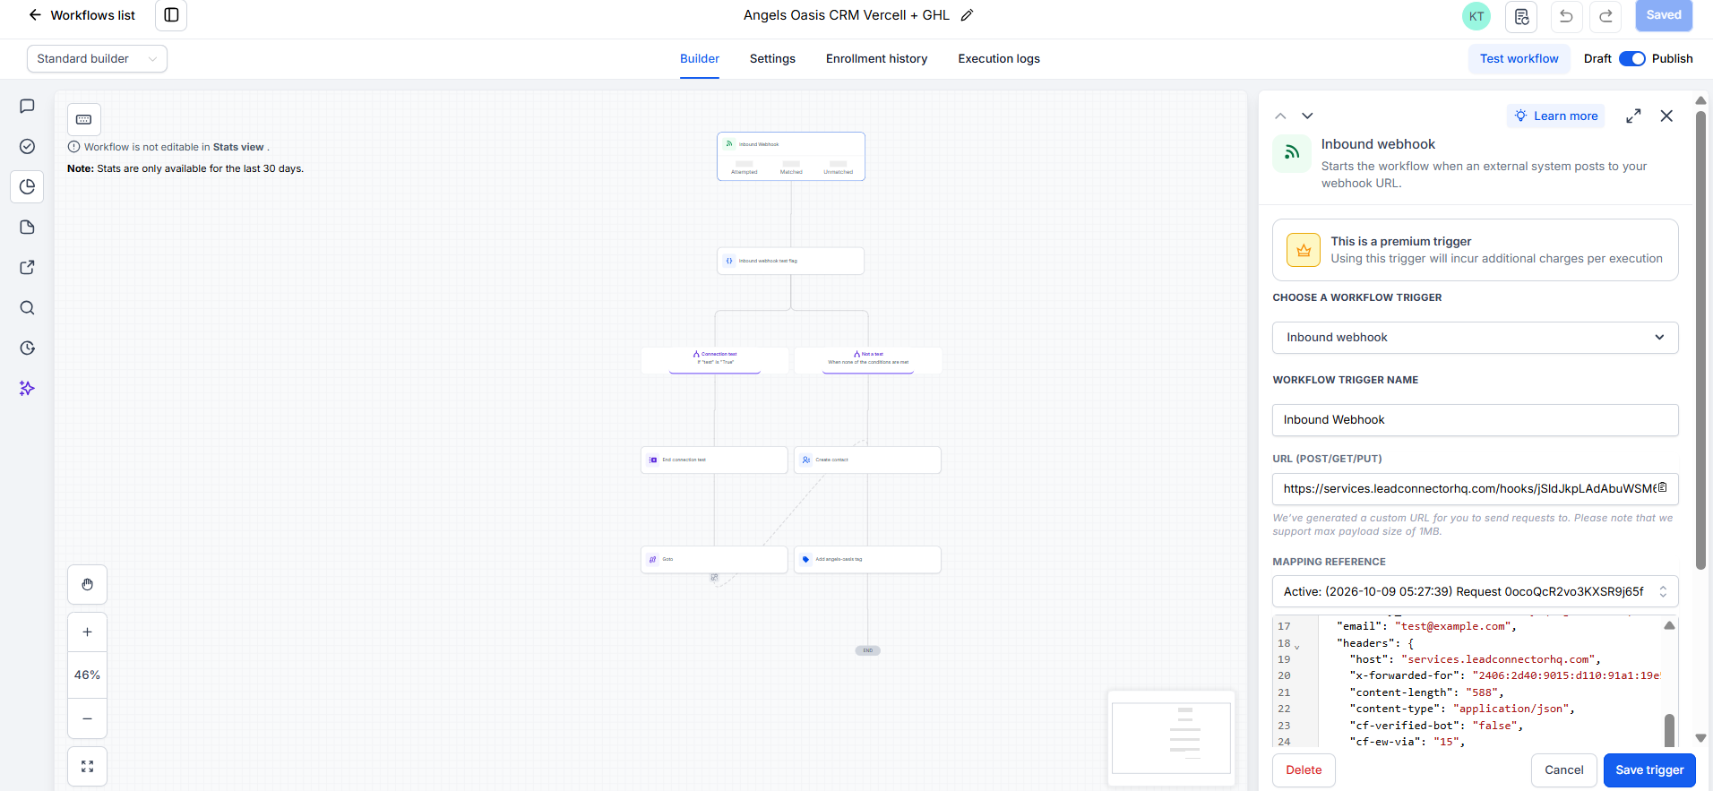


Built and tested inside GHL
PROOF SO FAR
GHL workflow “Angels Oasis CRM Vercel + GHL”: inbound webhook → create contact → add angels-oasis tag
GHL Marketing → Emails: all 8 referral emails built (drafts, Oct 15)
Proven: the webhook received its test request on Oct 9, and all 8 emails are in GHL
Not proven yet: automated sending from the CRM, which needs the access credentials
Notes:
On the left is the GHL workflow. It receives a webhook, creates the contact and tags it, and it received its test request on October 9. On the right are the eight emails, built in GHL as drafts. What is not proven yet is the automated sending, which is the research item from the How It Connects slide.

Slide 10

WHAT’S NEXT
Finish the email connection, then go live
1
Get the credentials
2
Test the connection
A GHL integration token and the Supabase service‑role key
Send a test email from the CRM through GHL to an internal inbox
3
Go live
4
Report weekly
Publish the 8 emails and start with the closest, best-fit leads
Share open, reply and tour-booking numbers every week
My request: I need the extra credentials for info@angelsoasisclhf.com to finish the email connection
Thank you · Questions?
Notes:
The first step is getting the credentials so I can finish and test the email connection. Once a test email goes through, we publish the emails, launch with our best leads, and I'll report the numbers weekly. To do that, I need the extra credentials for info@angelsoasisclhf.com. Thank you, and I'm happy to take questions.

